Slide 1



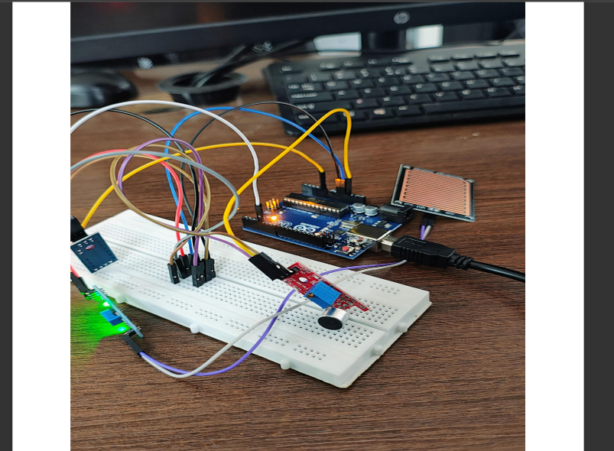
Weather Monitoring System
Name:A.Varshini Name:Samreen Name:N.Ruchitha Name:Pragathi Name:Shaik Tauseef Ali
Email Id :2203a51830@sru.edu.in Email Id:2203a51829@sru.edu.in Email Id:2203a51121@sru.edu.in Email Id:2203a51099@sru.edu.in Email Id:2203a51618@sru.edu.in
Department of Computer Science and Engineering,
SR University
Introduction to Weather Monitoring SystemA Weather Monitoring System is a technological solution designed to observe, collect, and analyze atmospheric conditions in real-time or over a period of time. These systems utilize various sensors to measure parameters such as temperature, humidity, atmospheric pressure, wind speed and direction, rainfall, and sometimes solar radiation.Modern weather monitoring systems are crucial in numerous fields including agriculture, aviation, environmental research, and disaster management. They range from simple, local weather stations to complex, networked systems integrated with IoT (Internet of Things) and satellite data. These systems not only aid in daily weather forecasting but also play a vital role in tracking climate changes and issuing early warnings for extreme weather events.By providing timely and accurate data, weather monitoring systems enhance decision-making, promote public safety, and support scientific research.
Results
The implemented system successfully records and transmits key atmospheric conditions. Real-time updates are visualized on both the local display and mobile application. Data transmission over LoRa ensures wide coverage with minimal power consumption, making it ideal for rural or remote deployment. Integration with cloud services enables historical data tracking and future weather predictions based on trends.
Literature Review:Several recent studies highlight the importance of IoT in environmental monitoring. Previous systems focused on standalone stations that lacked interconnectivity or mobile access. Research shows the advantage of using microcontrollers like ESP32 for real-time data processing and LoRa/Wi-Fi modules for long-range communication. Enhanced by cloud integration and mobile apps, modern systems now offer dynamic weather visualization, remote access, and data archiving.
Materials and Methods
Materials:
Microcontroller: Arduino UNO or ESP32 (main control unit)Sensors:DHT11/DHT22 (temperature & humidity)BMP180/BMP280 (air pressure)Rain sensor module Light intensity sensor (LDR or BH1750)Wireless Module :Lo Ra (SX1278) for long-range transmission or Wi-Fi module (ESP32 built-in)GPS Module (optional): For geotagged weather data Display: OLED or LCD to show real-time readings Power Supply: Battery or regulated DC supply Cloud Integration: Firebase, Thing speak, or Blynk for remote access Smartphone (Android): For receiving and visualizing weather data via app
.
Conclusion:
The Smart IoT-Based Weather Monitoring System provides a reliable and efficient method for collecting and sharing weather data. Its real-time functionality, low power usage, and remote accessibility make it suitable for both urban and rural environments. Future developments may include AI-based predictions and machine learning for advanced climate modeling.
Methods:
Sensor Integration: Sensors are interfaced with the microcontroller to monitor real-time weather parameters.Data Processing: The microcontroller reads sensor values and applies threshold checks or formatting as needed.Wireless Communication: Data is sent wirelessly using LoRa/Wi-Fi to a receiver or cloud server.Data Visualization: The receiver unit or cloud platform stores and displays data in real-time graphs or values.Mobile App Interface: A mobile application displays weather data in a user-friendly interface, optionally with location tagging.Local Display: A screen on the device continuously shows temperature, humidity, and other metrics for manual observation.
References
Sharma, A., & Patel, V. (2022). IoT Applications in Weather Monitoring. International Journal of Engineering Research.Zhang, Y. et al. (2021). Wireless Sensor Networks for Climate Data Collection. Sensors Journal.Arduino.cc and ESP32.io official documentation for hardware setup.Firebase & Blynk documentation for IoT integration

